Slide 1
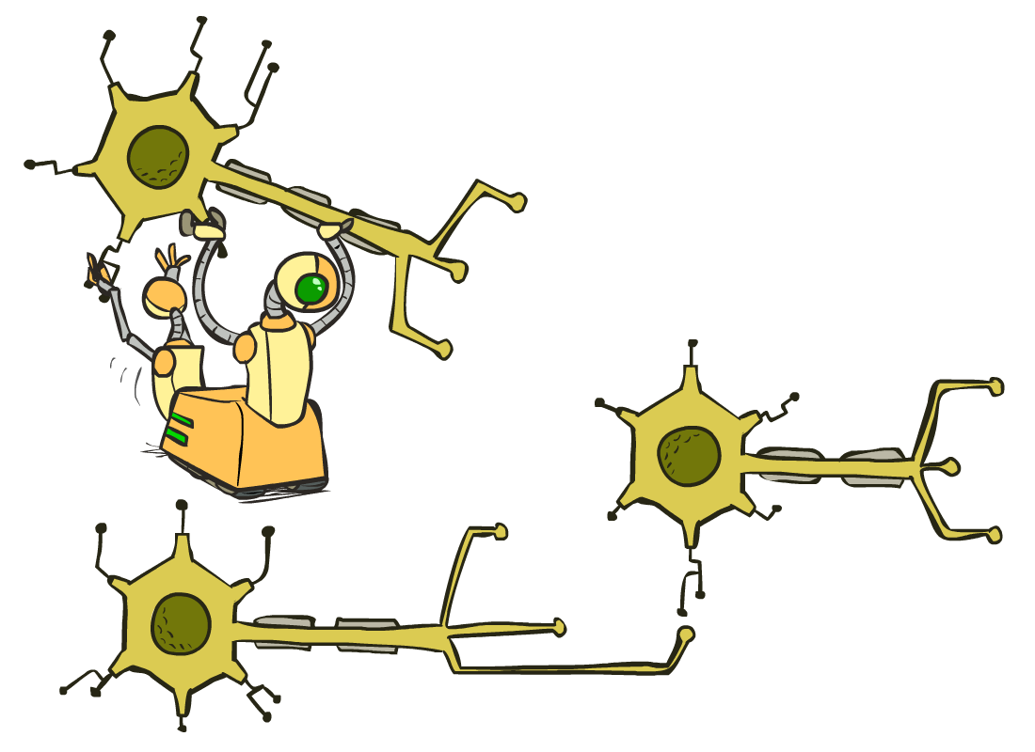
CS 188: Artificial Intelligence
Optimization and Neural Nets
Instructor: Pieter Abbeel--- University of California, Berkeley
[These slides were created by Dan Klein, Pieter Abbeel, Anca Dragan for CS188 Intro to AI at UC Berkeley. All CS188 materials are available at http://ai.berkeley.edu.]
Notes:
Please retain proper attribution, including the reference to ai.berkeley.edu. Thanks!

Slide 2
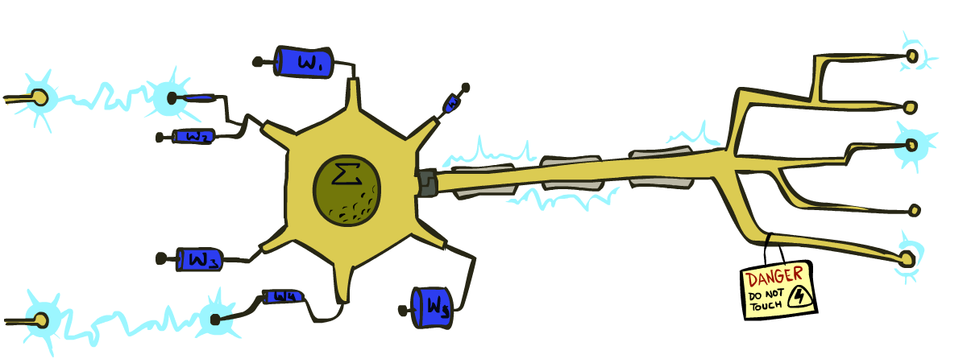
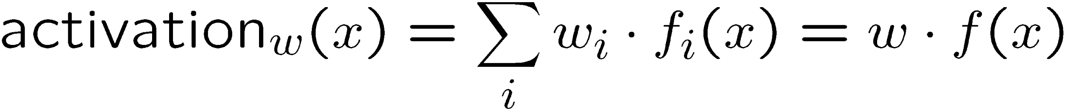
Reminder: Linear Classifiers
Inputs are feature values
Each feature has a weight
Sum is the activation
If the activation is:
Positive, output +1
Negative, output -1
w₁
f₁
Σ
w₂
>0?
f₂
w₃
f₃

Slide 3
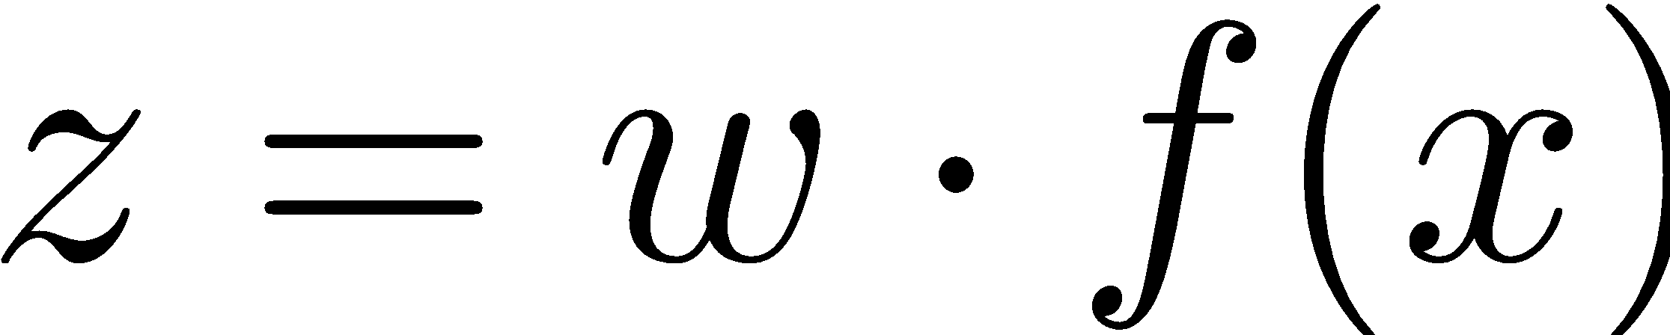
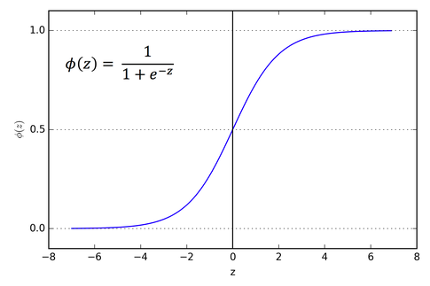
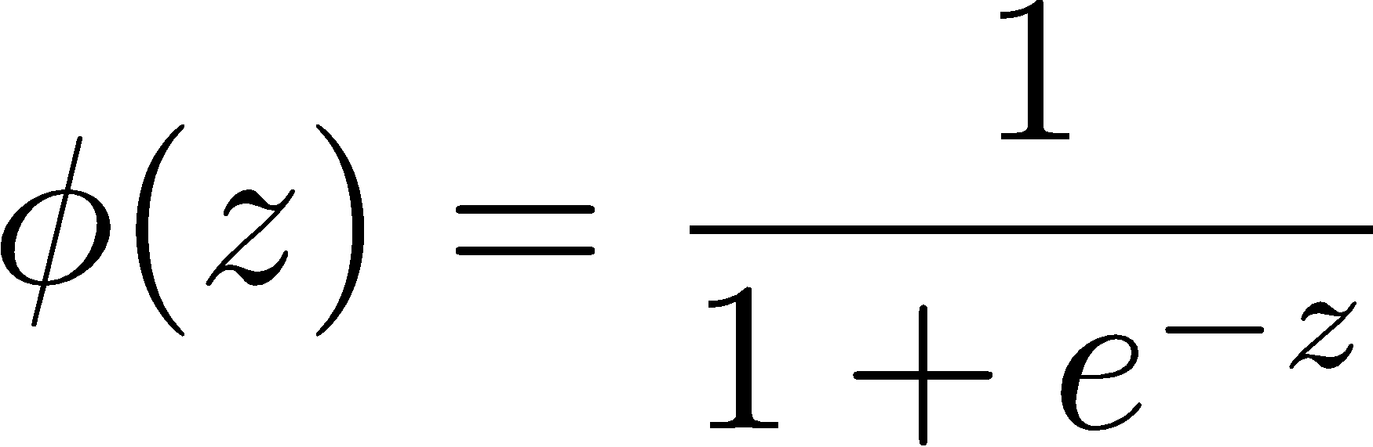
How to get probabilistic decisions?
Activation:
If very positive 🡪 want probability going to 1
If very negative 🡪 want probability going to 0
Sigmoid function

Slide 4
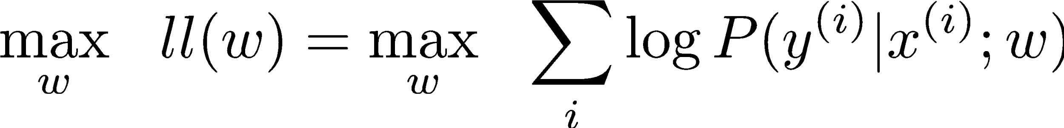
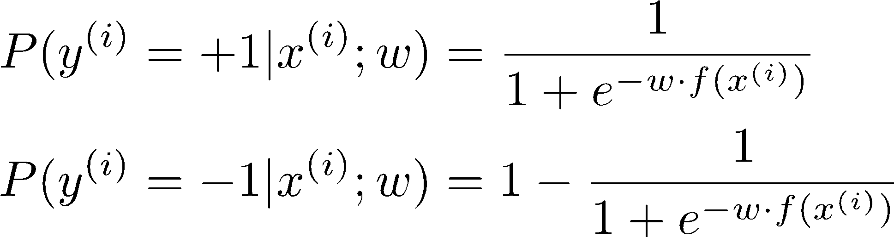
Best w?
Maximum likelihood estimation:
with:
= Logistic Regression

Slide 5
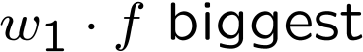


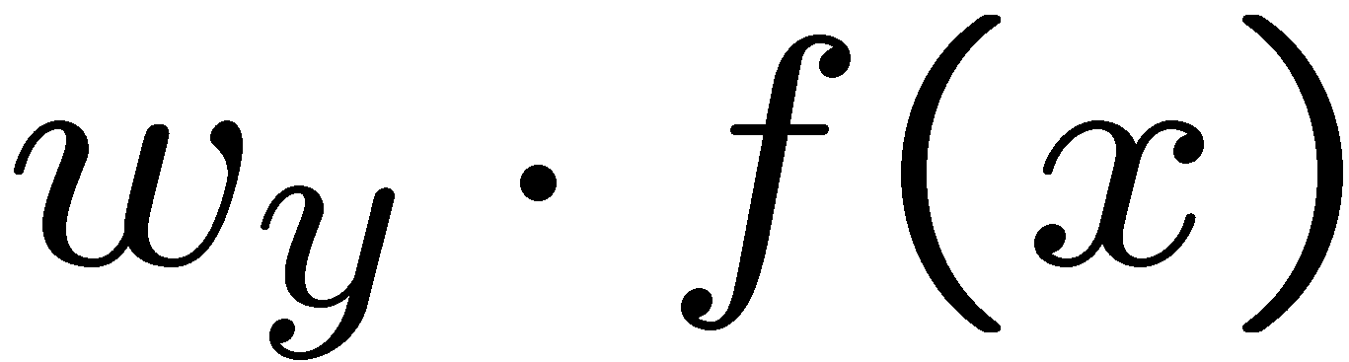


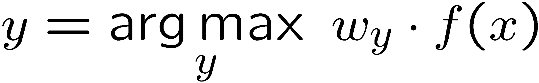
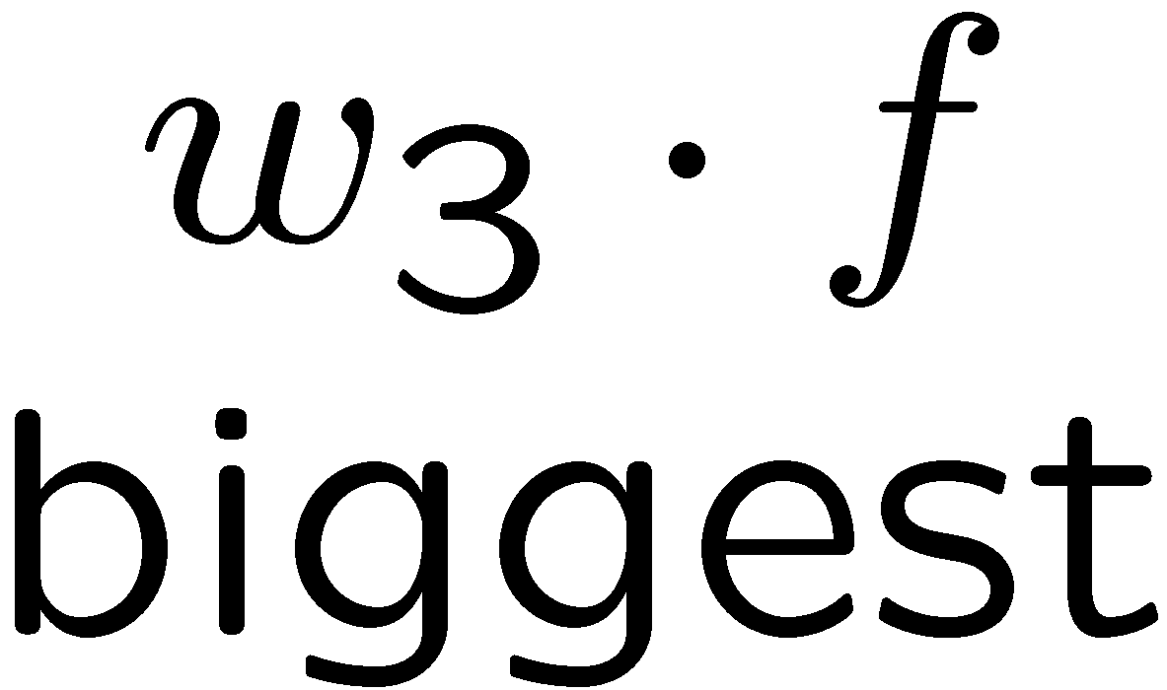
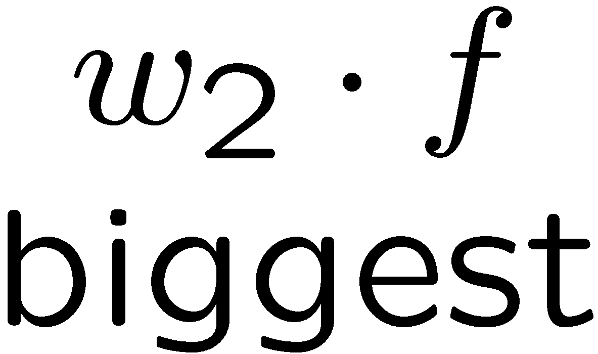
Multiclass Logistic Regression
Multi-class linear classification
A weight vector for each class:
Score (activation) of a class y:
Prediction w/highest score wins:
How to make the scores into probabilities?
original activations
softmax activations

Slide 6
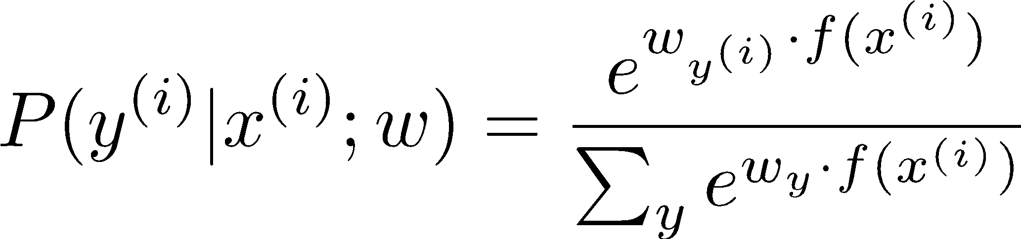
Best w?
Maximum likelihood estimation:
with:
= Multi-Class Logistic Regression

Slide 7
This Lecture
Optimization
i.e., how do we solve:

Slide 8

Hill Climbing
Recall from CSPs lecture: simple, general idea
Start wherever
Repeat: move to the best neighboring state
If no neighbors better than current, quit
What’s particularly tricky when hill-climbing for multiclass logistic regression?
Optimization over a continuous space
Infinitely many neighbors!
How to do this efficiently?

Slide 9
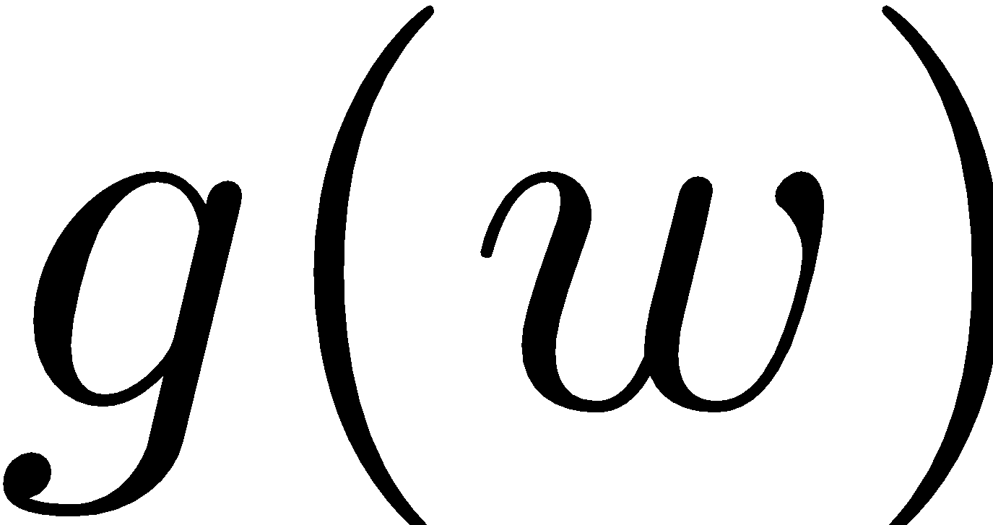
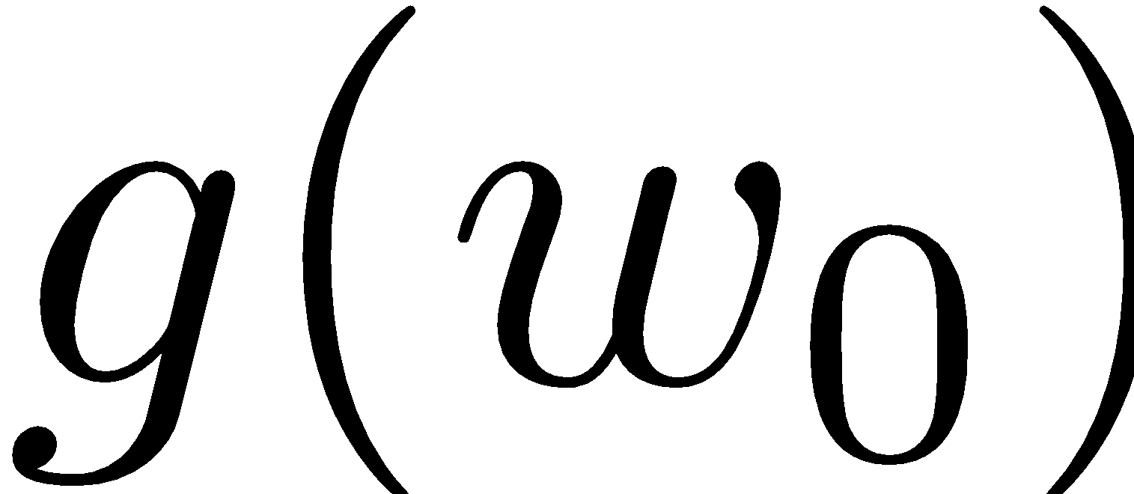


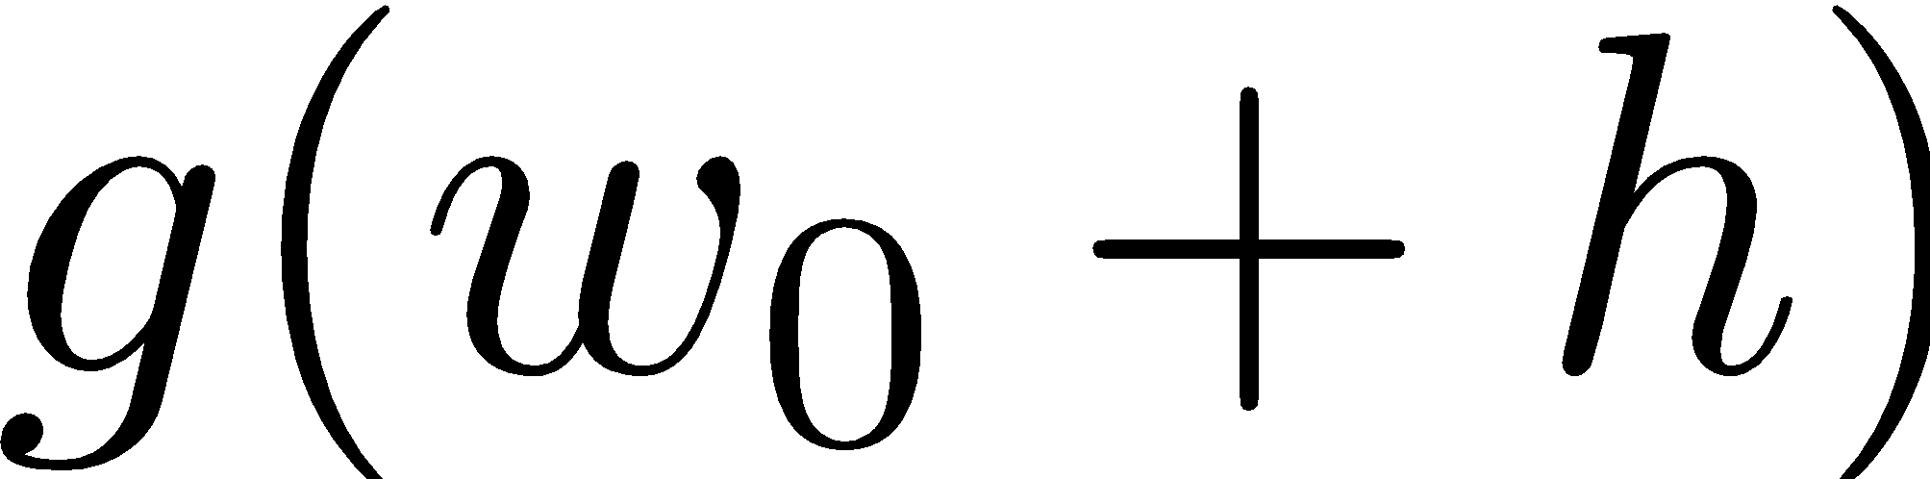
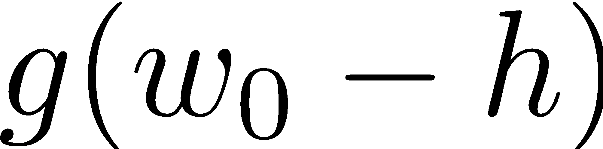
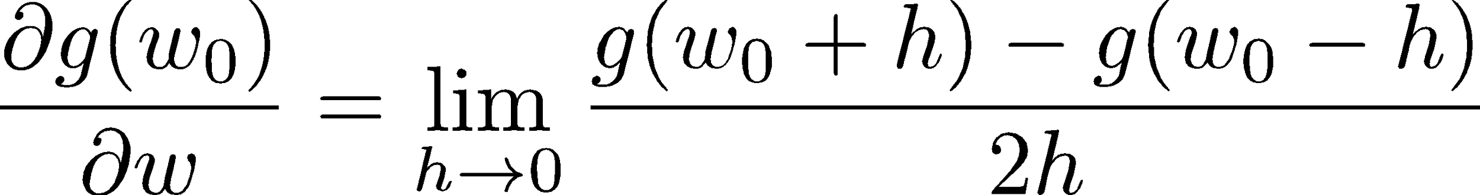
1-D Optimization
Could evaluate and
Then step in best direction
Or, evaluate derivative:
Tells which direction to step into

Slide 10
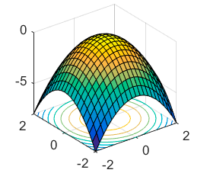
2-D Optimization
Source: offconvex.org

Slide 11
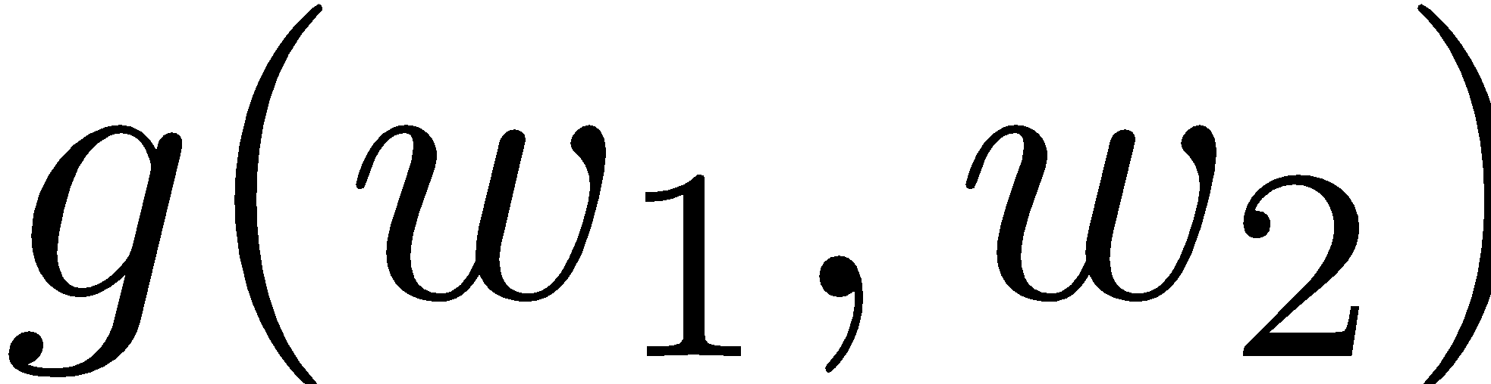
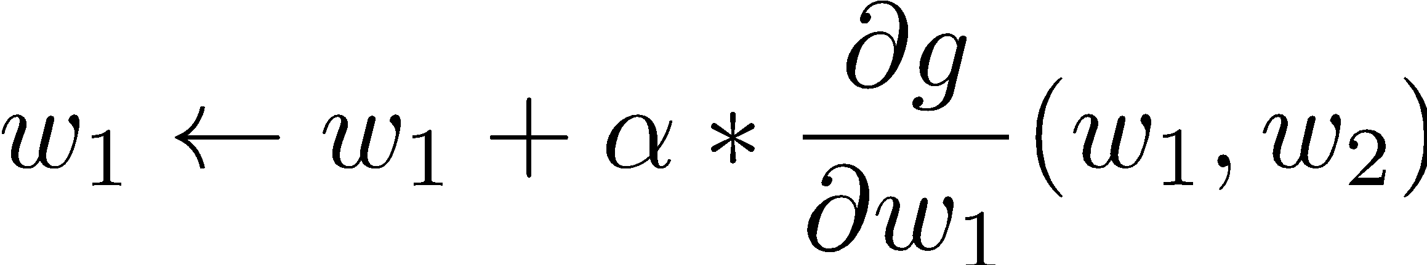
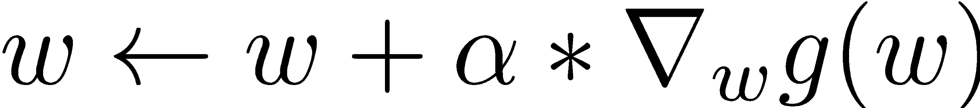
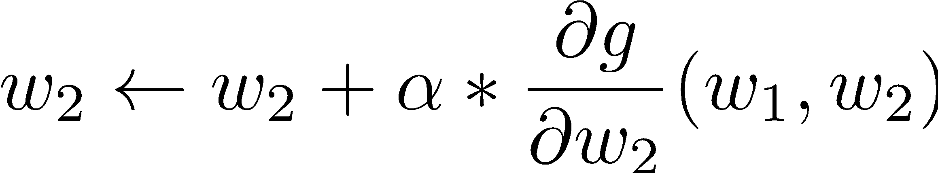
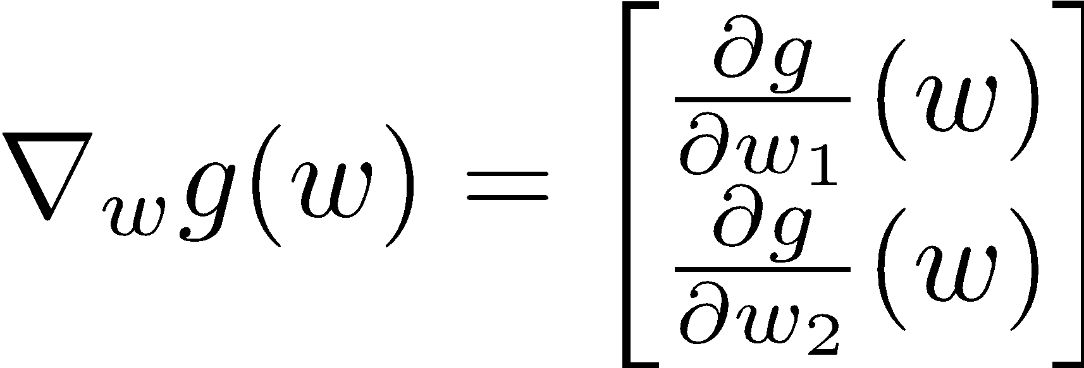
Gradient Ascent
Perform update in uphill direction for each coordinate
The steeper the slope (i.e. the higher the derivative) the bigger the step for that coordinate
E.g., consider:
Updates:
Updates in vector notation:
with:
= gradient

Slide 12
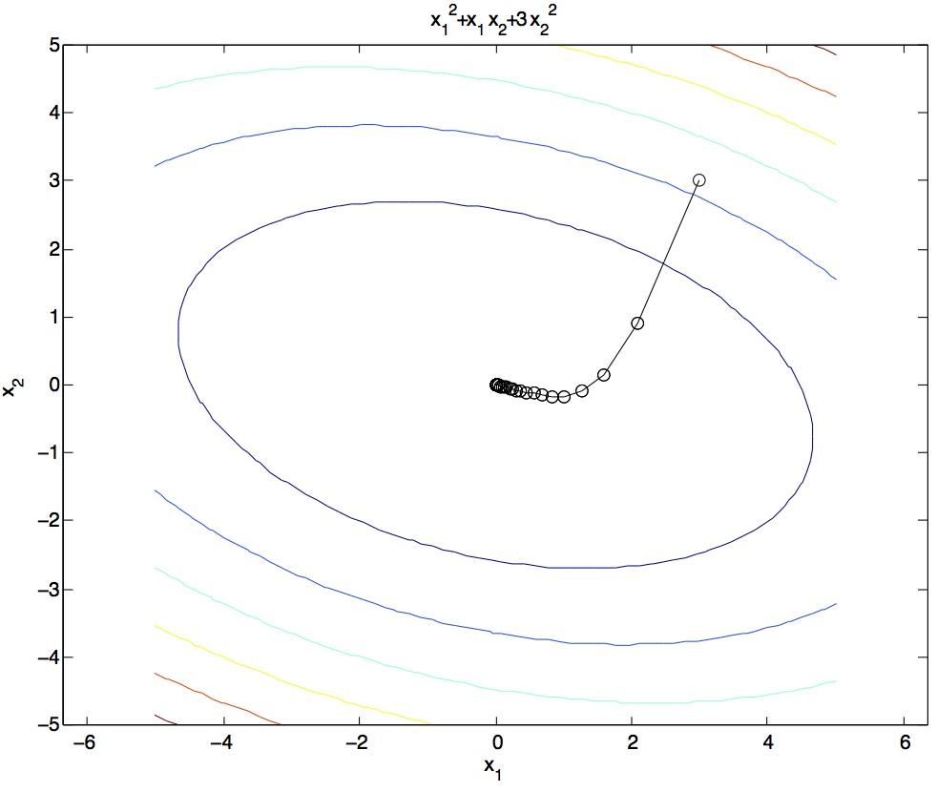
Gradient Ascent
Idea:
Start somewhere
Repeat: Take a step in the gradient direction
Figure source: Mathworks

Slide 13
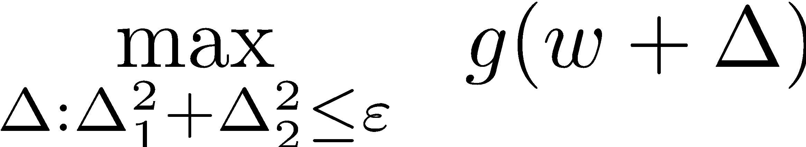
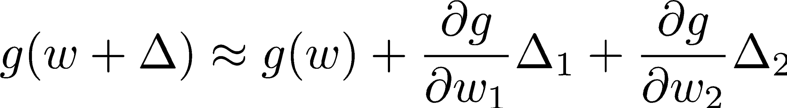
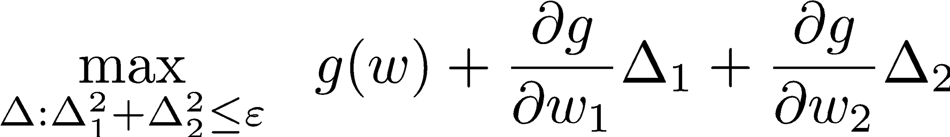
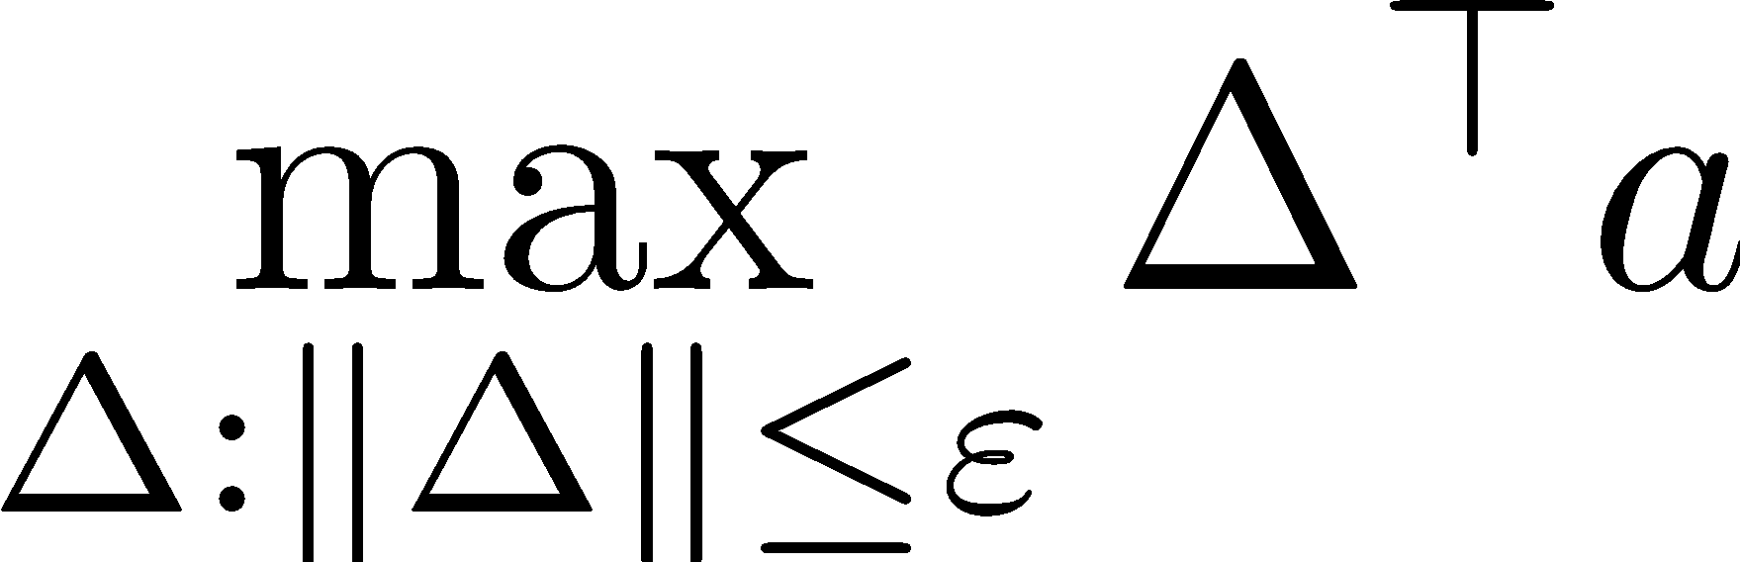
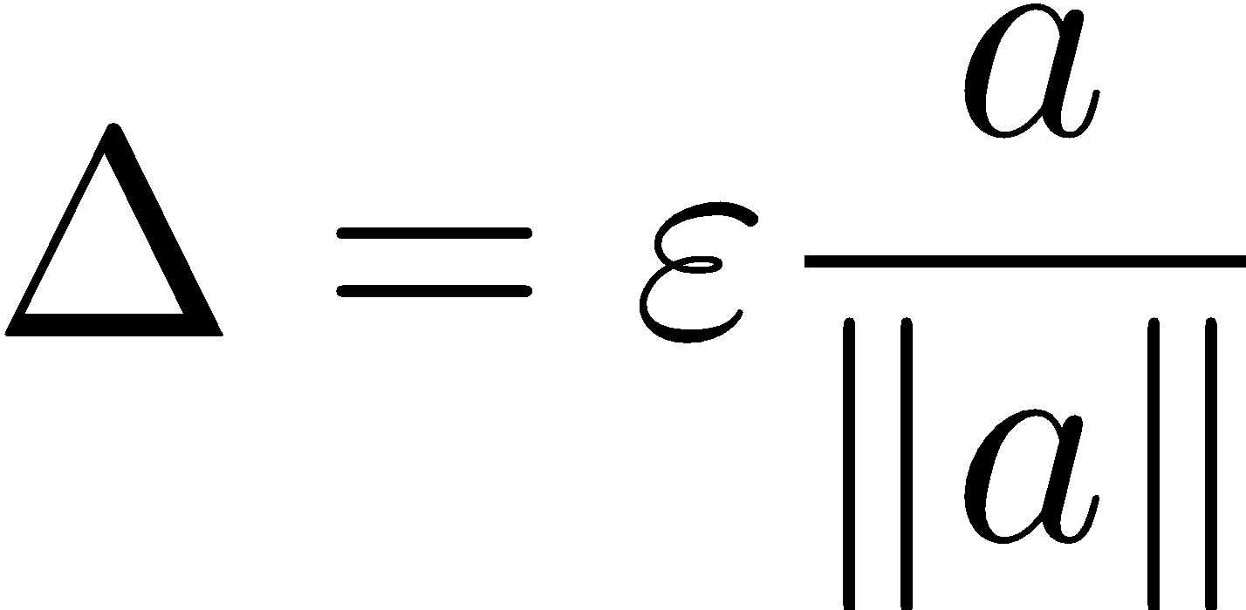
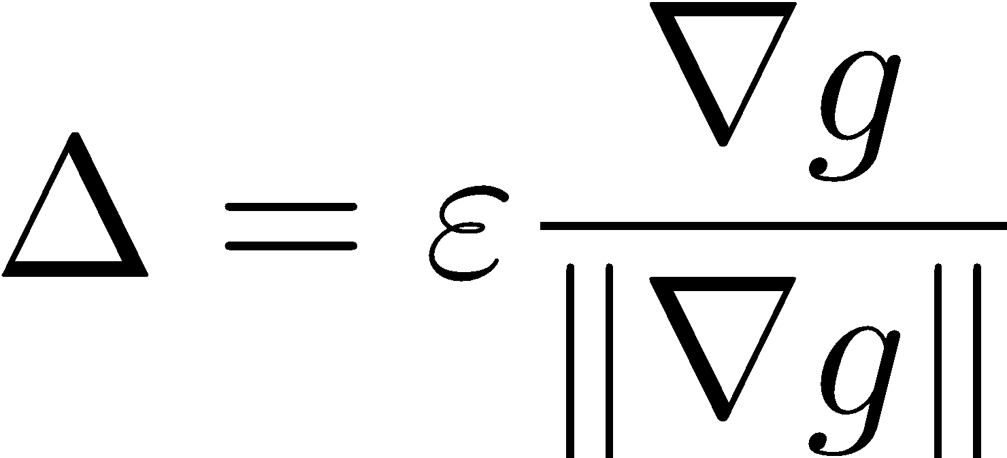
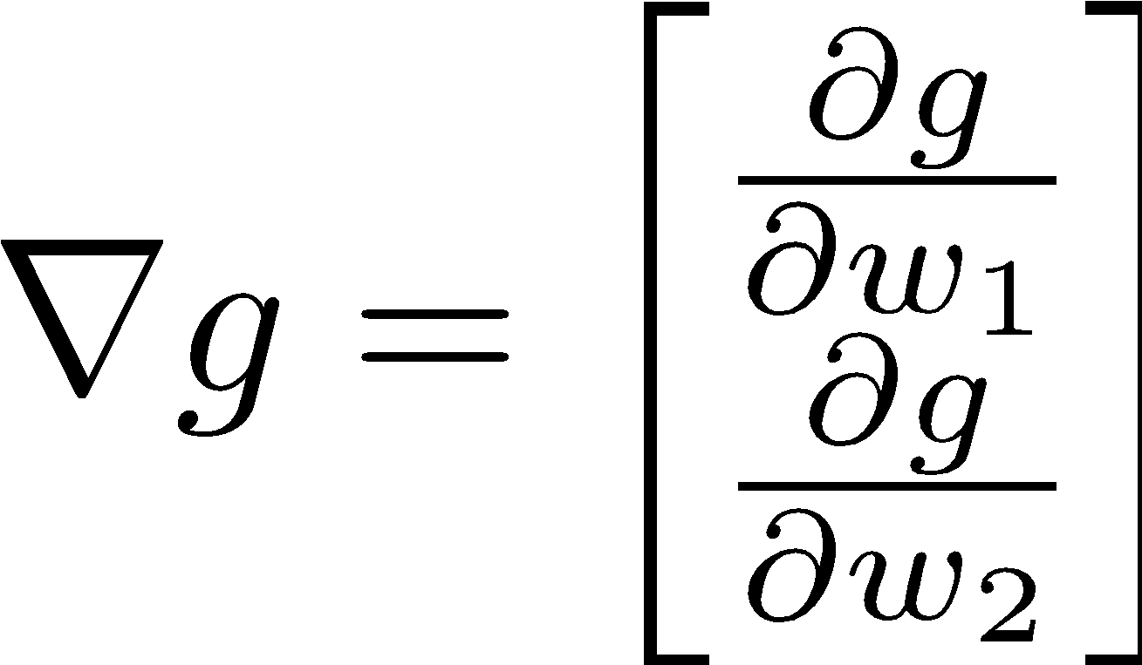
What is the Steepest Direction?*
First-Order Taylor Expansion:
Steepest Ascent Direction:
Recall: 🡪
Hence, solution:
Gradient direction = steepest direction!

Slide 14
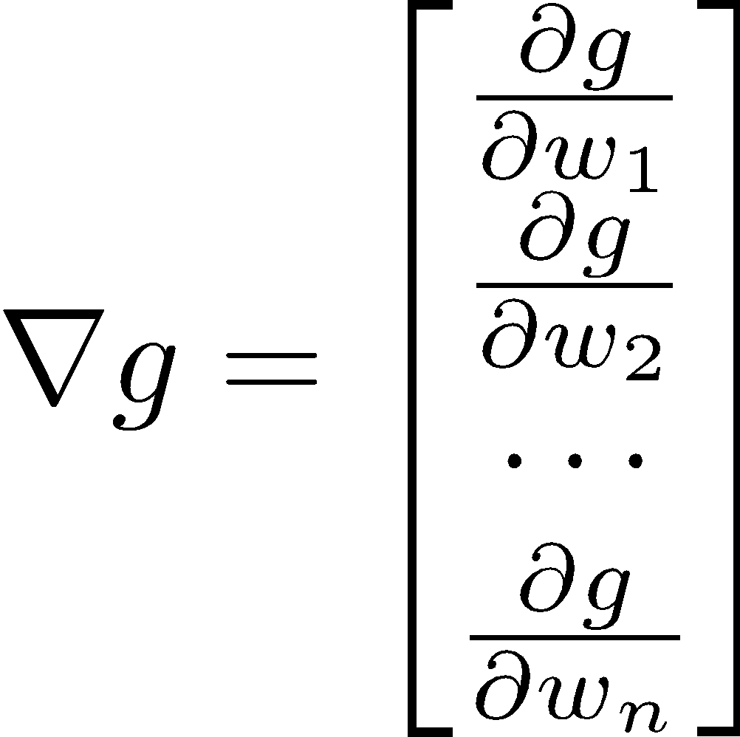
Gradient in n dimensions

Slide 15
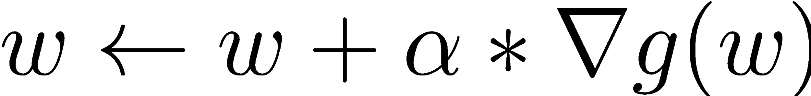

Optimization Procedure: Gradient Ascent
init
for iter = 1, 2, …
: learning rate --- tweaking parameter that needs to be chosen carefully
How? Try multiple choices
Crude rule of thumb: update changes about 0.1 – 1 %

Slide 16
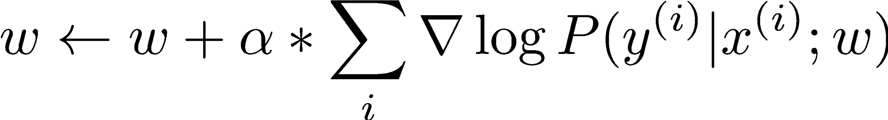
Batch Gradient Ascent on the Log Likelihood Objective
init
for iter = 1, 2, …

Slide 17
Stochastic Gradient Ascent on the Log Likelihood Objective
Observation: once gradient on one training example has been computed, might as well incorporate before computing next one
init
for iter = 1, 2, …
pick random j

Slide 18
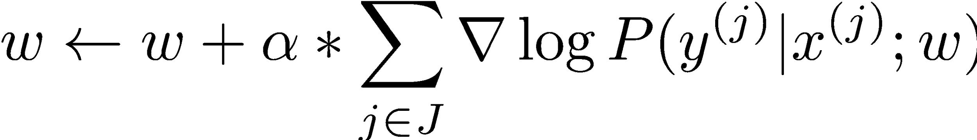
Mini-Batch Gradient Ascent on the Log Likelihood Objective
Observation: gradient over small set of training examples (=mini-batch) can be computed in parallel, might as well do that instead of a single one
init
for iter = 1, 2, …
pick random subset of training examples J

Slide 19
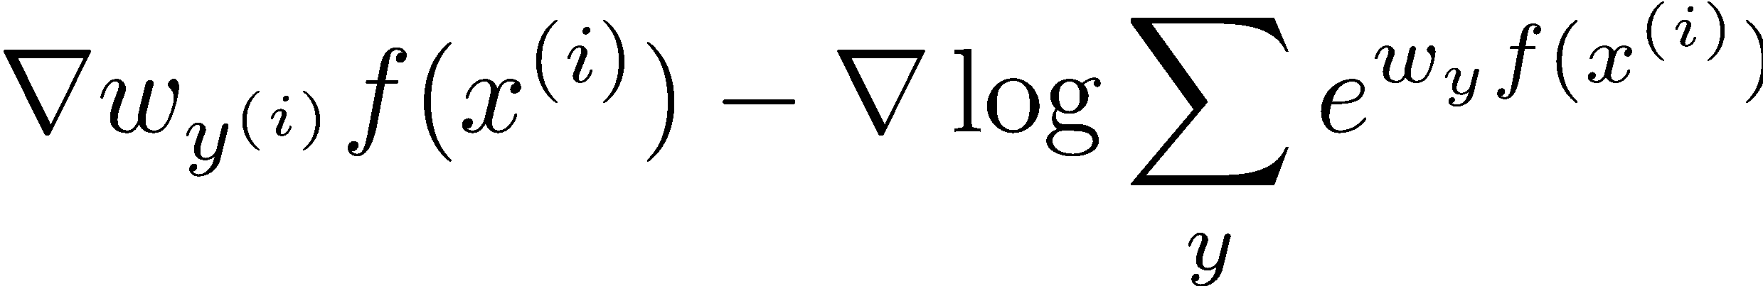
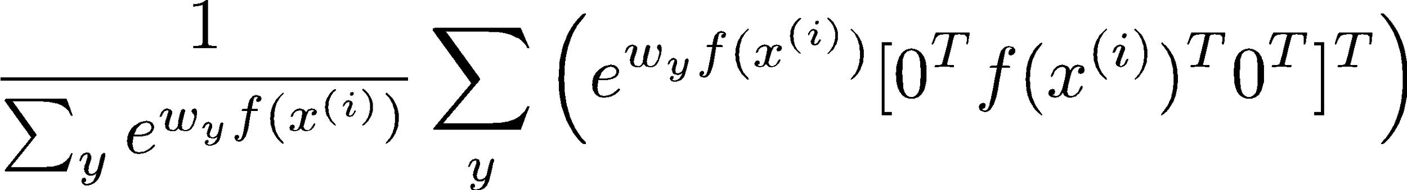
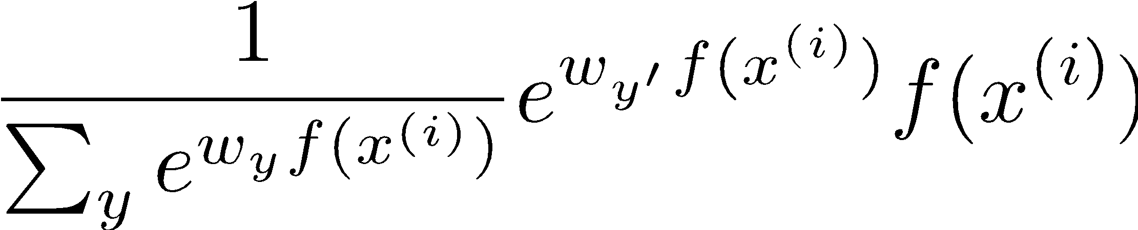
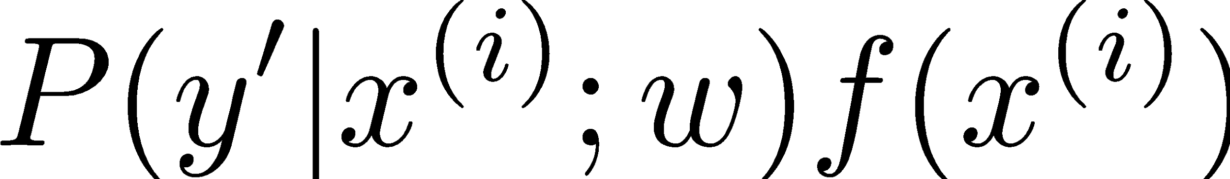
What will gradient ascent do in multi-class logistic regression?
adds f to the correct class weights
for y’ weights:
subtracts f from y’ weights in proportion to the probability current weights give to y’

Slide 20
How about computing all the derivatives?
We’ll talk about that once we covered neural networks, which are a generalization of logistic regression

Slide 21
Neural Networks

Slide 22
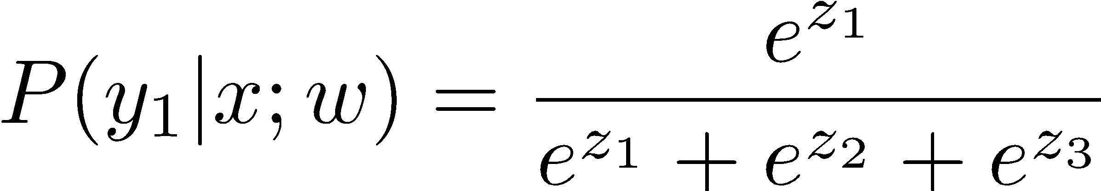
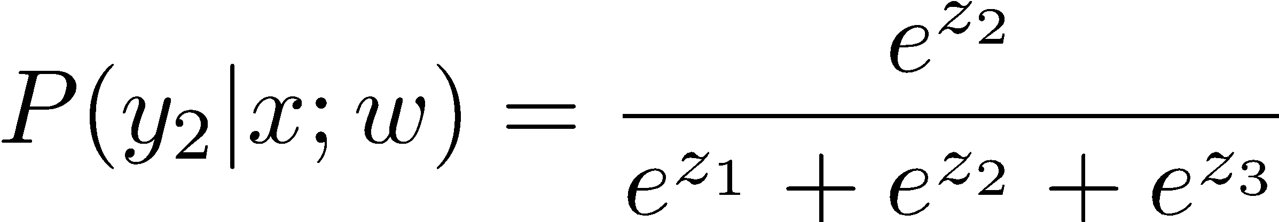
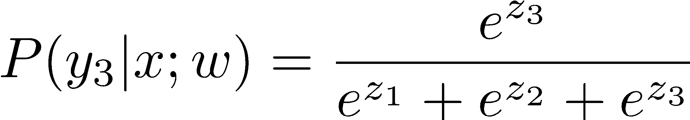
Multi-class Logistic Regression
= special case of neural network
f₁(x)
z₁
softmax
f₂(x)
z₂
f₃(x)
…
z₃
f_{K}(x)

Slide 23
Deep Neural Network = Also learn the features!
f₁(x)
z₁
softmax
f₂(x)
z₂
f₃(x)
…
z₃
f_{K}(x)

Slide 24
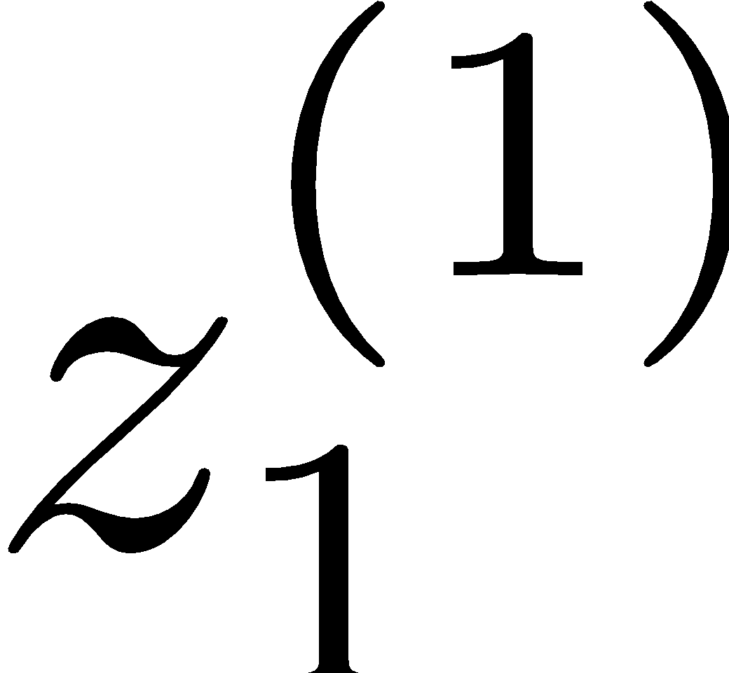
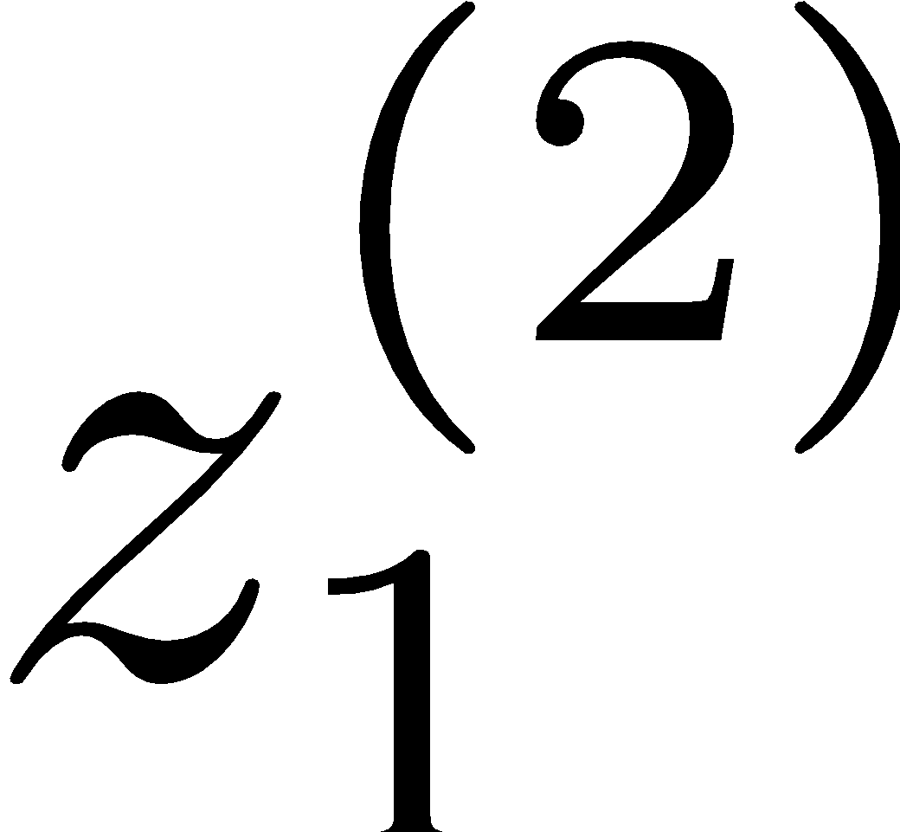
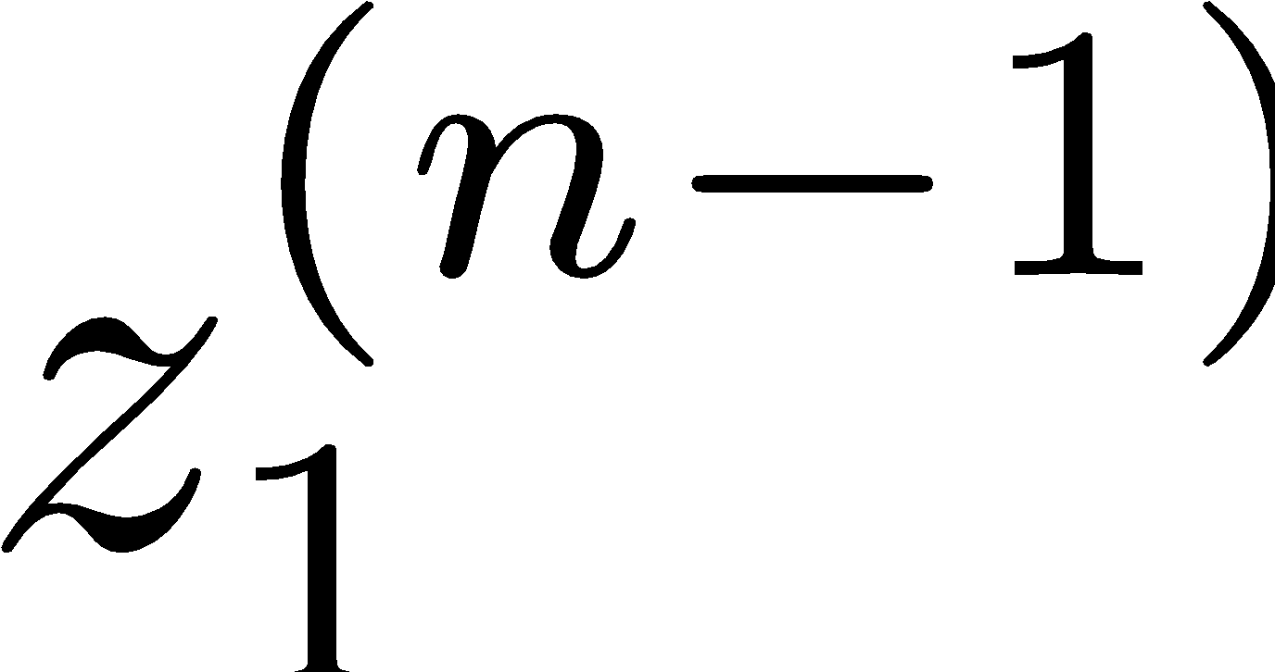
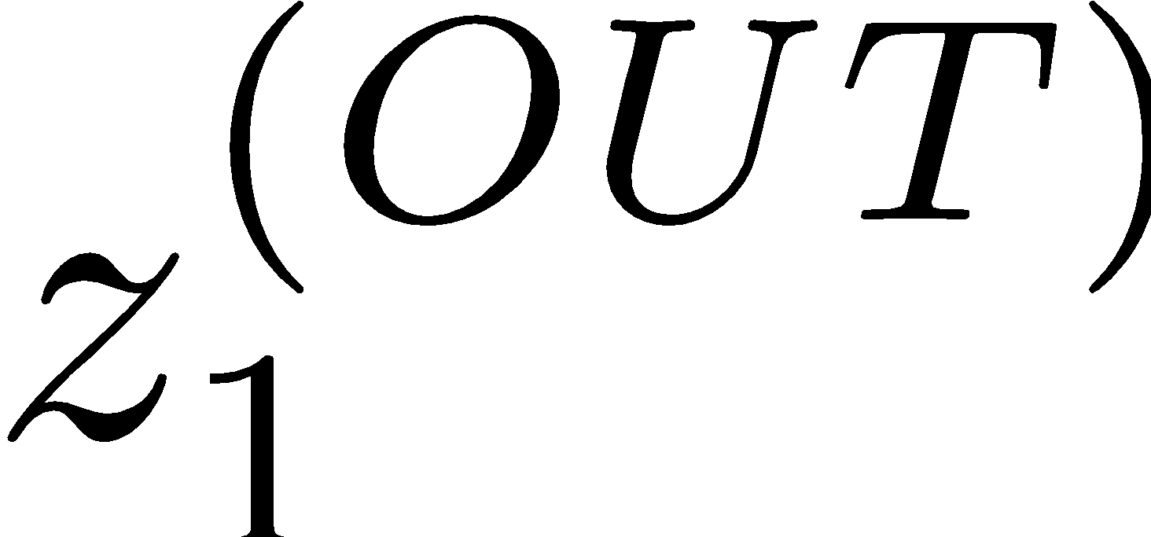
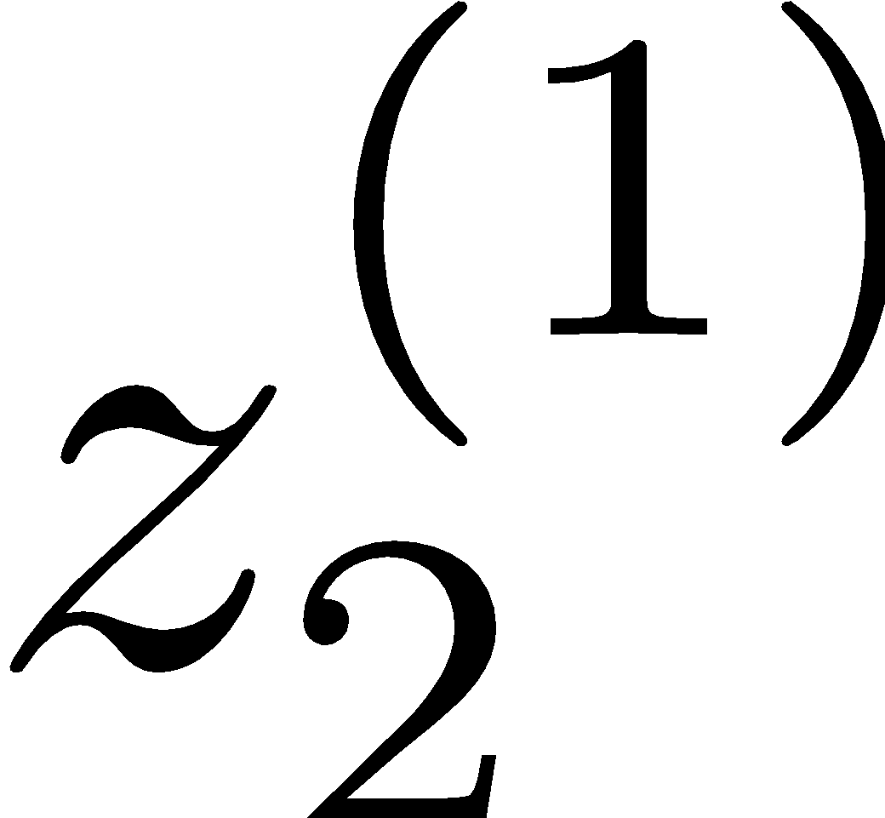
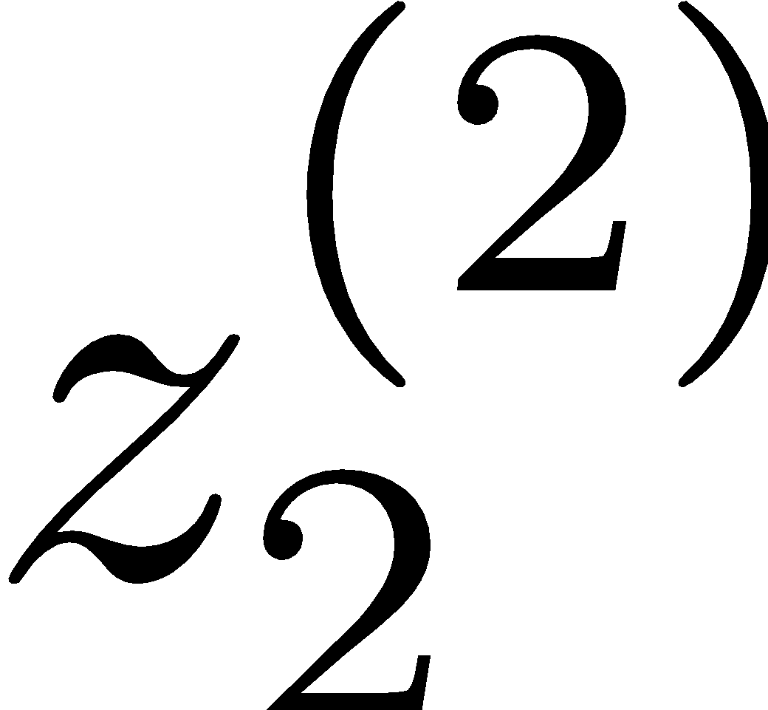














Deep Neural Network = Also learn the features!
x₁
f₁(x)
softmax
x₂
f₂(x)
…
x₃
f₃(x)
…
…
…
…
…
x_{L}
f_{K}(x)
g = nonlinear activation function

Slide 25
Deep Neural Network = Also learn the features!
x₁
softmax
x₂
…
x₃
…
…
…
…
…
x_{L}
g = nonlinear activation function

Slide 26

Common Activation Functions
[source: MIT 6.S191 introtodeeplearning.com]

Slide 27
Deep Neural Network: Also Learn the Features!
Training the deep neural network is just like logistic regression:
just w tends to be a much, much larger vector ☺
just run gradient ascent
+ stop when log likelihood of hold-out data starts to decrease

Slide 28
Neural Networks Properties
Theorem (Universal Function Approximators). A two-layer neural network with a sufficient number of neurons can approximate any continuous function to any desired accuracy.
Practical considerations
Can be seen as learning the features
Large number of neurons
Danger for overfitting
(hence early stopping!)

Slide 29

Universal Function Approximation Theorem*
In words: Given any continuous function f(x), if a 2-layer neural network has enough hidden units, then there is a choice of weights that allow it to closely approximate f(x).
Cybenko (1989) “Approximations by superpositions of sigmoidal functions”
Hornik (1991) “Approximation Capabilities of Multilayer Feedforward Networks”
Leshno and Schocken (1991) ”Multilayer Feedforward Networks with Non-Polynomial Activation Functions Can Approximate Any Function”

Slide 30



Universal Function Approximation Theorem*
Cybenko (1989) “Approximations by superpositions of sigmoidal functions”
Hornik (1991) “Approximation Capabilities of Multilayer Feedforward Networks”
Leshno and Schocken (1991) ”Multilayer Feedforward Networks with Non-Polynomial Activation Functions Can Approximate Any Function”

Slide 31
Fun Neural Net Demo Site
Demo-site:
http://playground.tensorflow.org/

Slide 32

How about computing all the derivatives?
Derivatives tables:
[source: http://hyperphysics.phy-astr.gsu.edu/hbase/Math/derfunc.html

Slide 33


How about computing all the derivatives?
But neural net f is never one of those?
No problem: CHAIN RULE:
If
Then
Derivatives can be computed by following well-defined procedures

Slide 34
Automatic Differentiation
Automatic differentiation software
e.g. TensorFlow, PyTorch, Jax
Only need to program the function g(x,y,w)
Can automatically compute all derivatives w.r.t. all entries in w
This is typically done by caching info during forward computation pass of f, and then doing a backward pass = “backpropagation”
Autodiff / Backpropagation can often be done at computational cost comparable to the forward pass
Need to know this exists
How this is done? -- outside of scope of CS188

Slide 35
How well does this all work?

Slide 36
Summary of Key Ideas
Optimize probability of label given input
Continuous optimization
Gradient ascent:
Compute steepest uphill direction = gradient (= just vector of partial derivatives)
Take step in the gradient direction
Repeat (until held-out data accuracy starts to drop = “early stopping”)
Deep neural nets
Last layer = still logistic regression
Now also many more layers before this last layer
= computing the features
🡪 the features are learned rather than hand-designed
Universal function approximation theorem
If neural net is large enough
Then neural net can represent any continuous mapping from input to output with arbitrary accuracy
But remember: need to avoid overfitting / memorizing the training data 🡪 early stopping!
Automatic differentiation gives the derivatives efficiently (how? = outside of scope of 188)

Slide 37
How well does it work?

Slide 38

Computer Vision
Notes:
38

Slide 39

Object Detection
Notes:
39

Slide 40



Manual Feature Design
Notes:
40

Slide 41

Features and Generalization
[HoG: Dalal and Triggs, 2005]
Notes:
41

Slide 42
Features and Generalization
Image
HoG
Notes:
HoG, SIFT, Daisy
Deformable part models
42

Slide 43

Performance
graph credit Matt Zeiler, Clarifai

Slide 44
Performance
graph credit Matt Zeiler, Clarifai

Slide 45
Performance
AlexNet
graph credit Matt Zeiler, Clarifai

Slide 46
Performance
AlexNet
graph credit Matt Zeiler, Clarifai

Slide 47
Performance
AlexNet
graph credit Matt Zeiler, Clarifai

Slide 48

MS COCO Image Captioning Challenge
Karpathy & Fei-Fei, 2015; Donahue et al., 2015; Xu et al, 2015; many more

Slide 49

Visual QA Challenge
Stanislaw Antol, Aishwarya Agrawal, Jiasen Lu, Margaret Mitchell, Dhruv Batra, C. Lawrence Zitnick, Devi Parikh

Slide 50



Speech Recognition
graph credit Matt Zeiler, Clarifai

Slide 51

Machine Translation
Google Neural Machine Translation (in production)
Notes:
https://research.googleblog.com/2016/09/a-neural-network-for-machine.html

